Slide 1
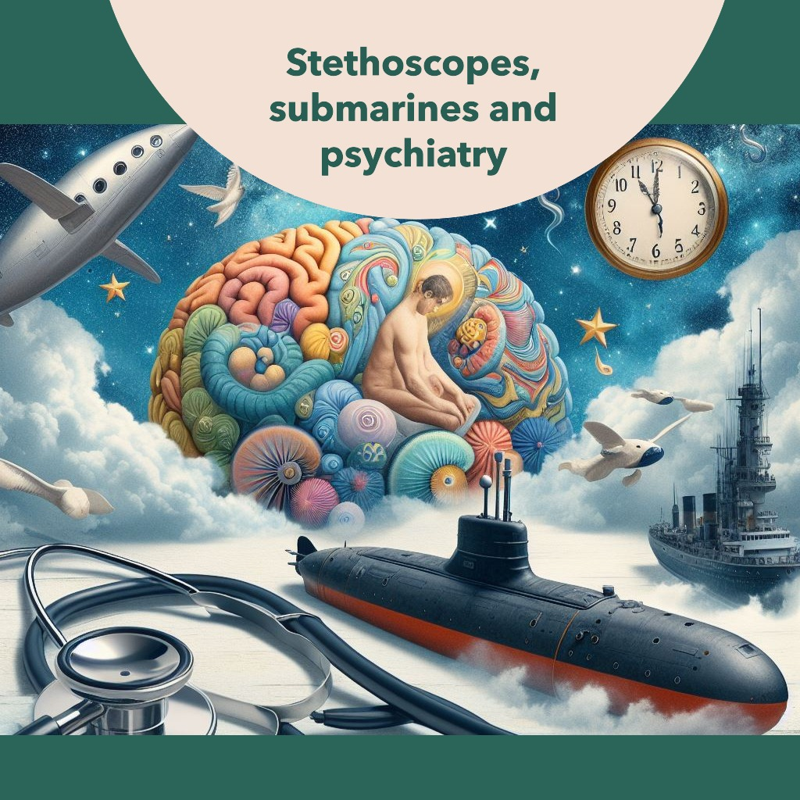

Slide 2
Stethoscopes, Submarines and Psychiatry
A journey from periscope to Clinical Director and the gig economy
Dr Nicholas Taylor

Slide 3
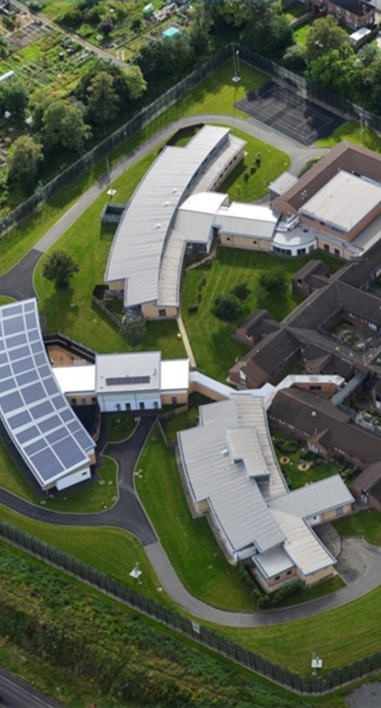
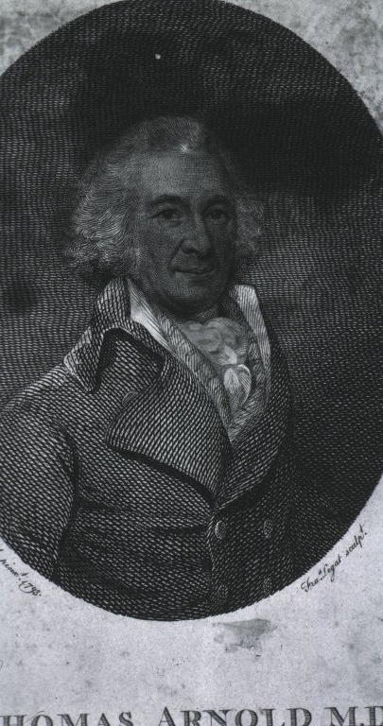
Why am I here?
When invited in the summer – Clinical Director of Arnold Lodge
100 beds in Humberstone
Forensic psychiatry

Slide 4

Audience
Medical students
Practising doctors
Retired doctors
?Medical student morale
Anyone considering (forensic) psychiatry?

Slide 5
My aims for this evening
Demonstrate scope of career opportunities
Convey sense of hope
Workforce pressures are wonderful for you

Slide 6

Awareness
My subjective experience
One point of view
There are other perspectives

Slide 7

My background
First in family to university
Medical school in Bristol
  GP interest & placements
  Teaching hospital surgery exam
  Undergraduate psychiatry
  Interests outside medicine - Nightline
House jobs (=FY) - smoking history, elderly patients
  Careers fairs
  Interests outside medicine - RNR

Slide 8

RNR
Written application
Invitation to HMS Sultan

Slide 9

Context - 1998
Pre-9/11
Pre-Iraq, Pre-Afghanistan
Recent conflicts:
Falklands (16 years before)
Bosnia – Dayton Accords
Desert Storm – 1990-1991
Positive recent influence
Second largest navy

Slide 10
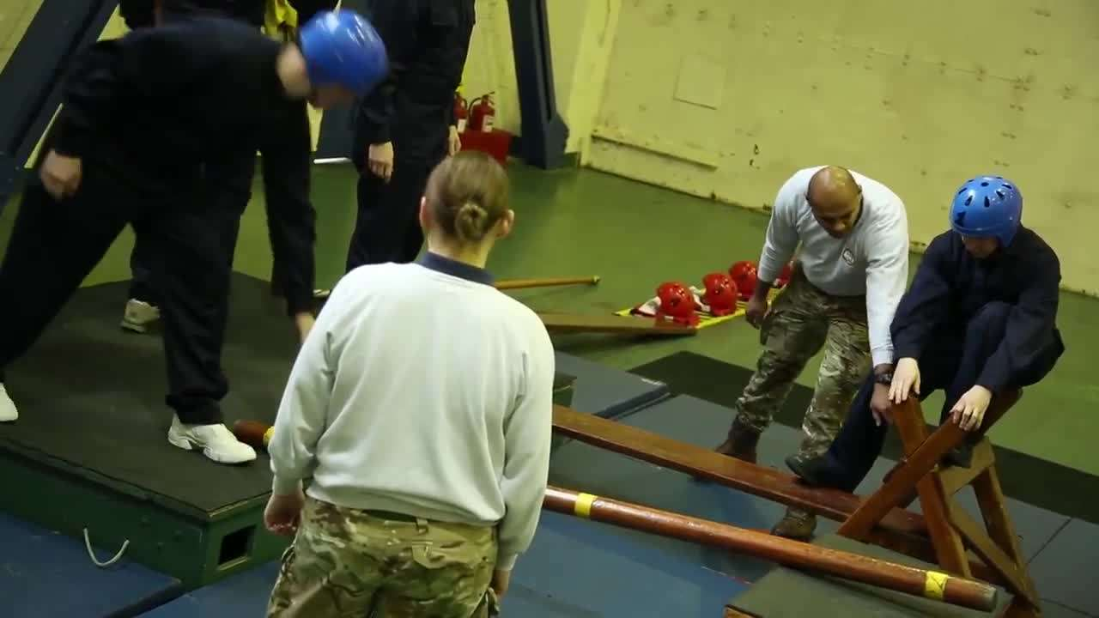
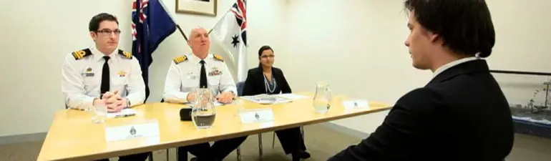
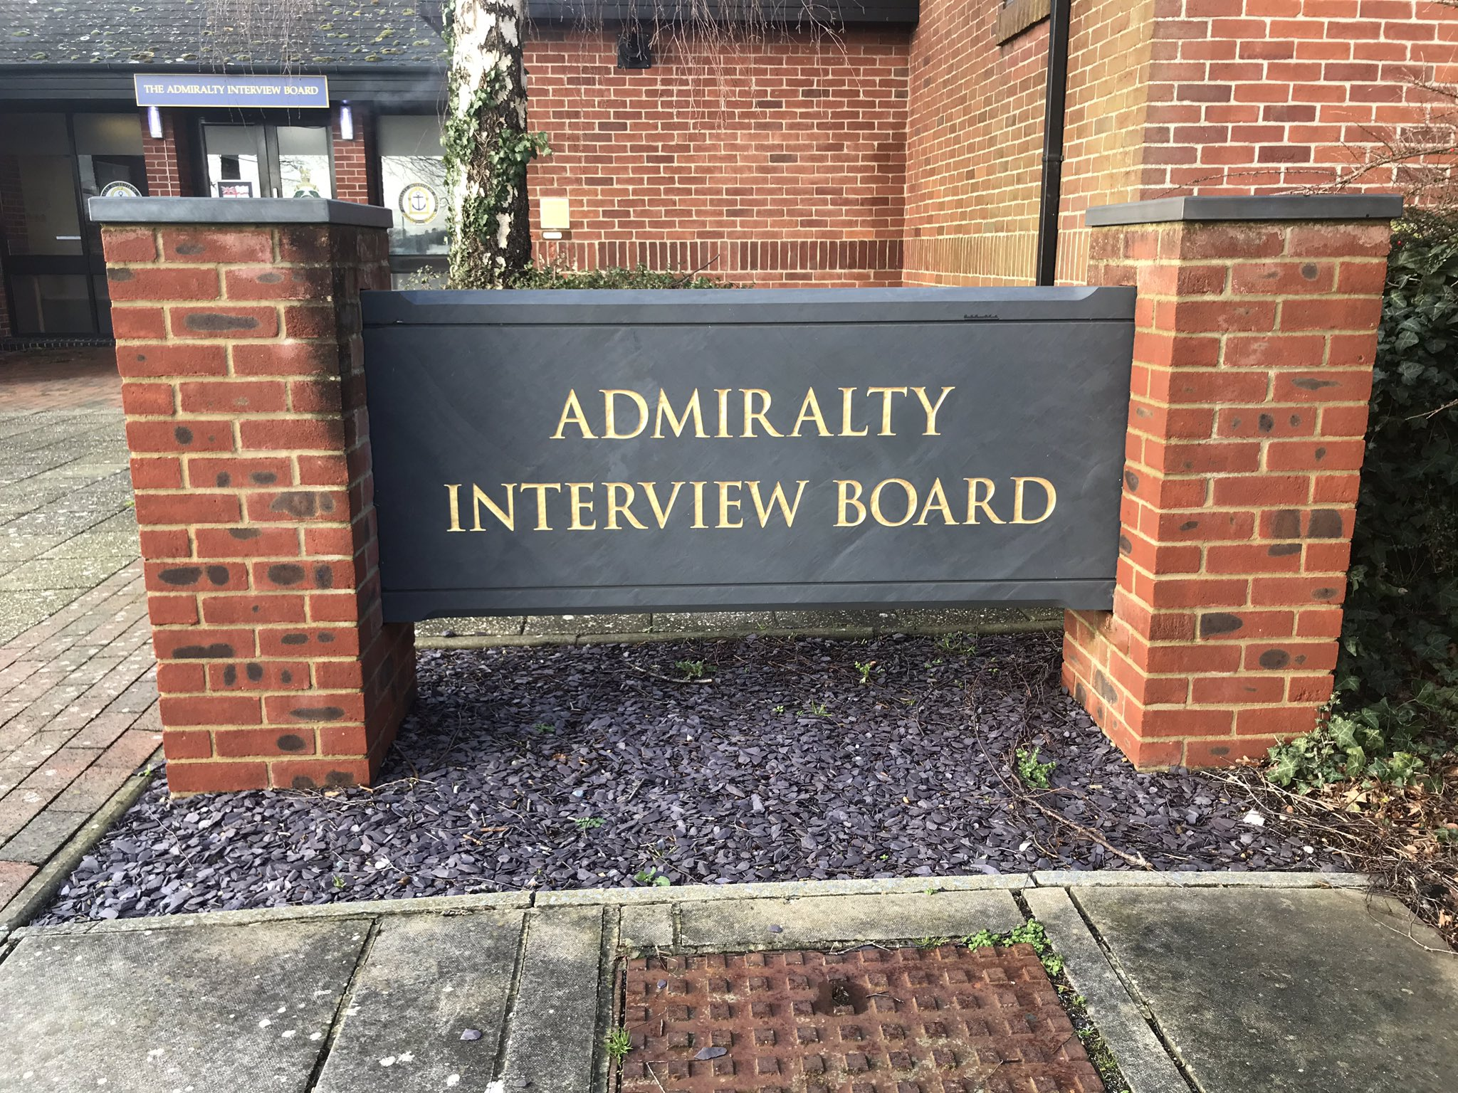
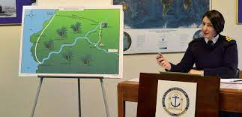
Admiralty Interview Board

Slide 11
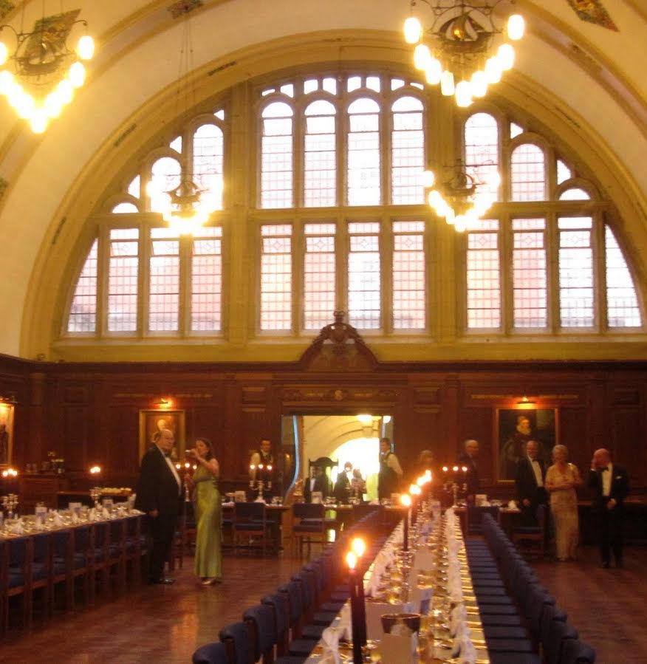
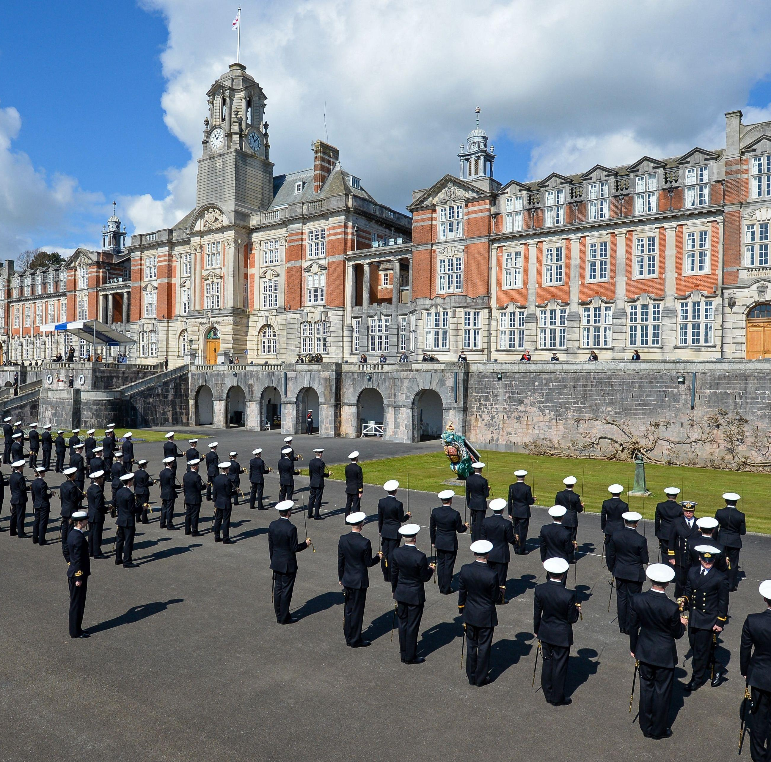

Britannia Royal Naval College

Slide 12

“Gap year”
6 months off after house jobs
London interview - question
Travelling
Offered time to the Navy
Medical workforce gaps

Slide 13
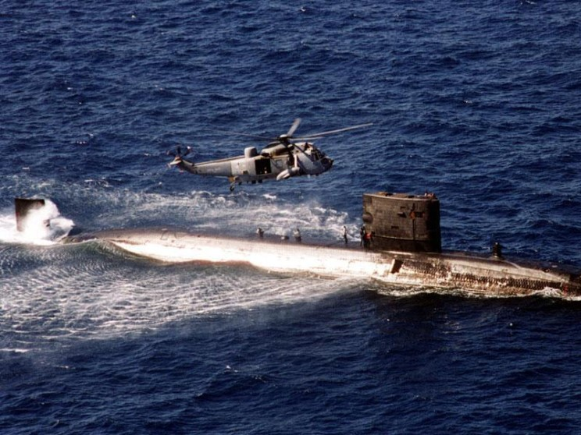
Appointer

Slide 14
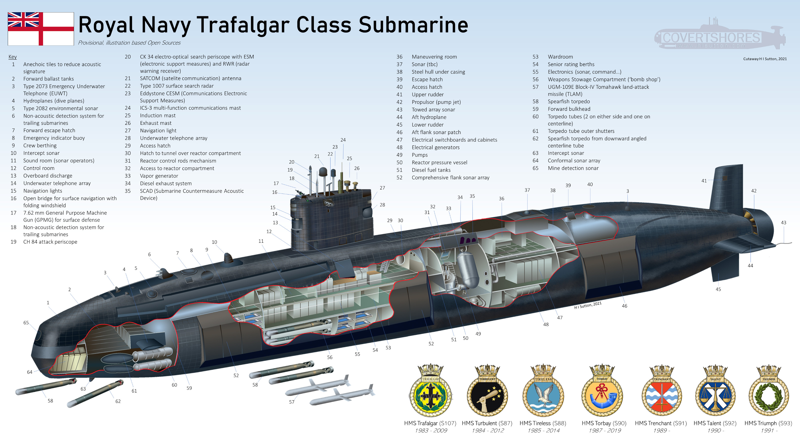
Notes:
Nuclear powered, no nuclear missiles
Torpedoes – later TLAM
Pump jet – no propellor
SMQ – spent time in engine room, valves, isolation, etc.
“Exam” – casual approach
Only male crew and homosexuality illegal

Slide 15
What’s the point?
“Designed to hunt out and destroy enemy submarines and surface ships, the Trafalgar Class have gradually been adapted to perform other roles, including covert surveillance and inshore reconnaissance.
- Royal Navy website

Slide 16
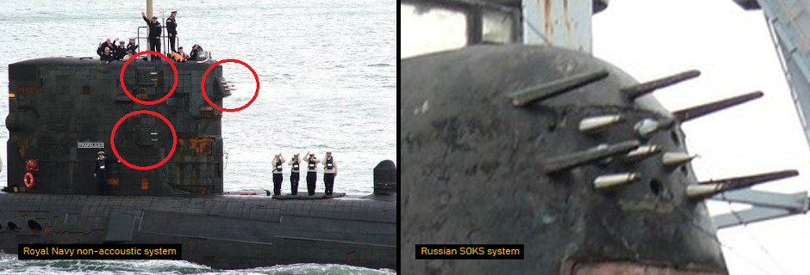

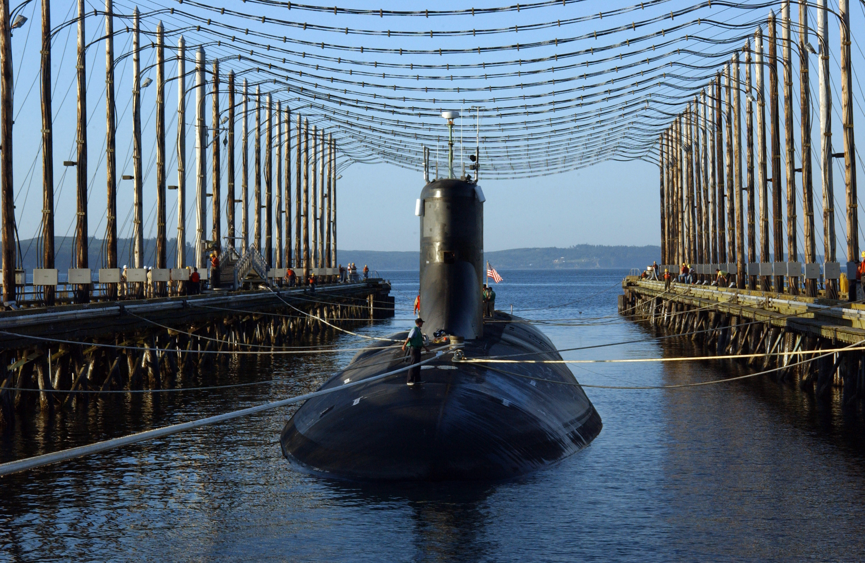


Undersea technologies

Slide 17



Slide 18

Submarine Medical Officer
Responsible for physical (and dental) health of all on board
MO, QuizzO, SLJO
Initial flurry of activity, control room duties, infection, scabies
Atmospheric monitoring and secondary coolant water monitoring
Missed research opportunity

Slide 19
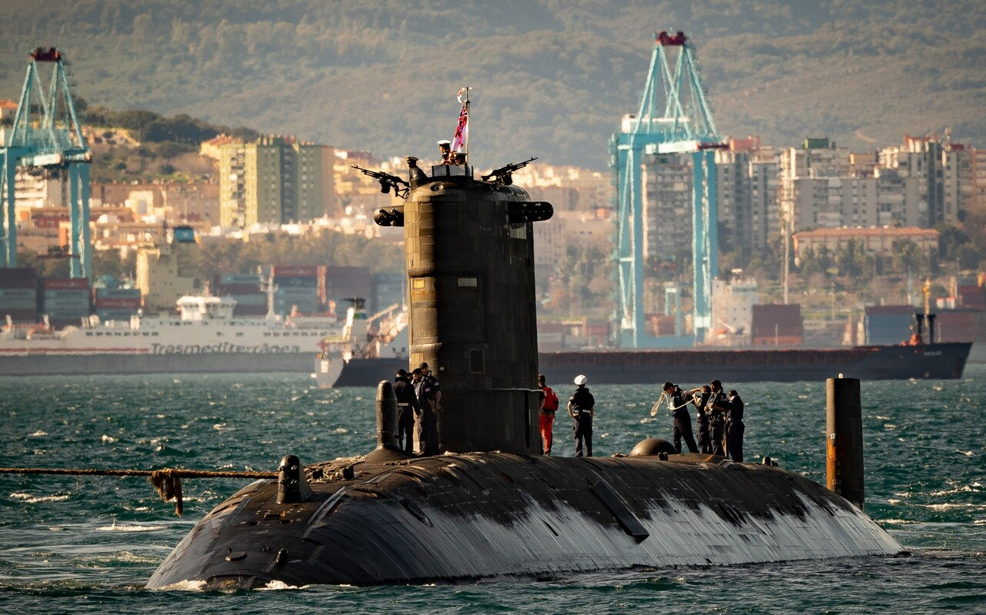
Back to reality

Slide 20
Brief diversion from psychiatry
Navy – trauma focussed
A&E – London – interview - suturing and fixing
Future wife – plastic surgery
Orthopaedics - delightful
Realisation
Psychiatry training application – Birmingham & Oxford

Slide 21

Psychiatry training
Old age psychiatry
Text from friend…
General adult
First forensic on call…
Forensic psychiatry
Learning disability
CAMHS

Slide 22
Forensic psychiatry
Psychiatry with the resources to do it properly
High, medium and low secure – expert witness
MSU – LoS 2-3 years
Consultant caseload – 12-15 (?outpatients)
Full MDT – psychology, social work, OT, nursing, ST doctor

Slide 23
Typical case
Young man, difficult childhood
Substance misuse, criminality
Onset of psychosis, schizophrenia
Non-compliance, substances
Index offence – often family
Remand then forensic psychiatry
Trial – opinion offered
Treatment in hospital

Slide 24
Forensic psychiatry
Often schizophrenia, schizoaffective disorder, bipolar AD
Depressed people stay at home and lack motivation
OCD and anxiety – rules bound, too worried
History and examination
Psychopathology – voices, delusions, etc
Psychopharmacology
Physical comorbidities

Slide 25
Unique specialty
No clinics
Travel for assessments – nationwide
Tiny caseload
Really strong multidisciplinary team
Extremely thorough understanding of patients
Expert witness work built in and required

Slide 26
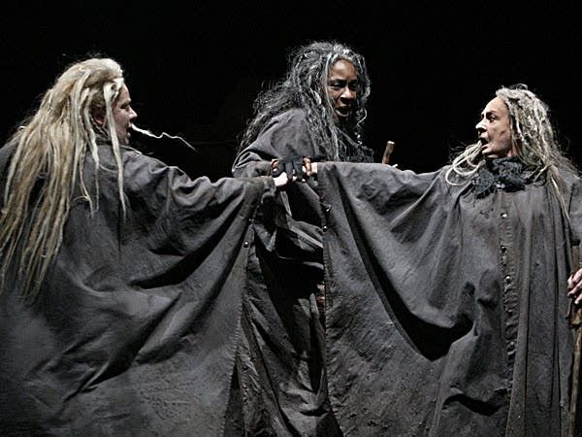
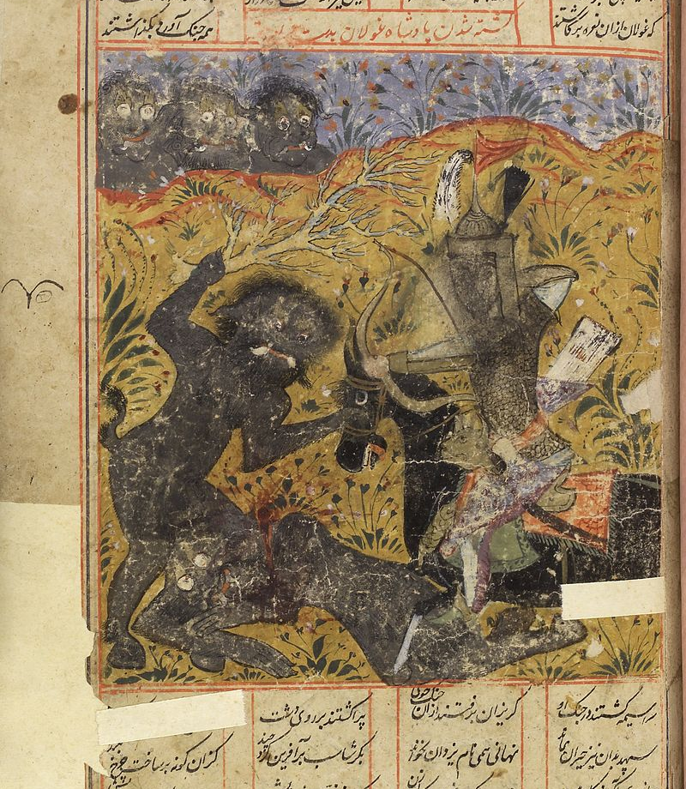
Need to understand patient’s view and beliefs

Slide 27
Context
Psychopathology - diagnosis
Understand in context of:
  Culture
  Religion
  Social
  Substances/alcohol
  Economic
  Relationships
  Criminal
Understand:
  Risk
  Management
  How this fits with the law

Slide 28
Hospital and/or custody
Prison sentence
Can be indeterminate/life
Hybrid Order (S45A of MHA)
S37 Hospital Order
S41 Restriction Order
Mental Health Act 1983
Problems
Prison sentence for someone who really needs treatment
Hospital Order for someone whose risks don’t respond to/engage in treatment
First time – bad
Second time - catastrophic

Slide 29
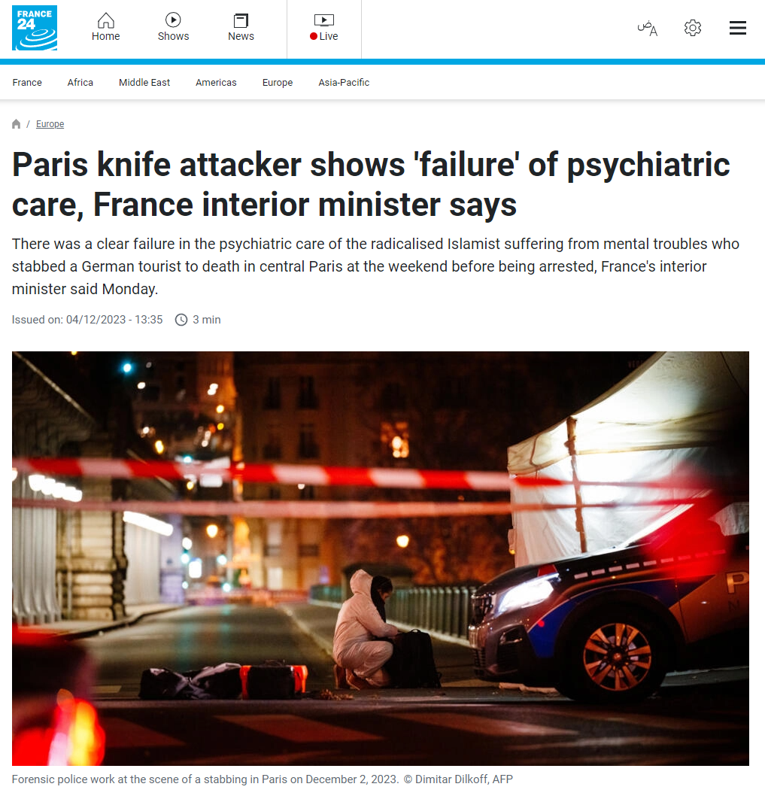
Success and failures in MSU treatment
Success = discharge to low secure or community
Failure = high secure transfer or prison
Real failure = harm to patient or others

Slide 30
Beyond the clinical
Education
Organise and give lectures/ courses
MRCPsych course
Psychology PhD
Undergraduate
OSCE
Personal tutor
Royal College - curriculum
Management
Sometimes worked towards
Sometimes by necessity
Specific project
Lead clinician
Appraiser
Clinical/Medical Director

Slide 31
Clinical Director – Arnold Lodge
My predecessor – 20 years
Out for lunch
Years of shadowing/leading
Full support of colleagues
Interview
Started March 2020
Covid
Life became simpler
Keep everyone alive
Governance and meetings disappeared
Job done

Slide 32
Post-covid
System-wide changes
Governance back with a vengeance
New organisations
Much reduced medical role
Sole responsibility to joint to triumvirate to quadrumvir
Still held responsibility for “clinical quality”
Responsibility without power
Much reduced autonomy
Enjoyment stopped – after 15 years as a consultant
Thinking of other options

Slide 33
By coincidence
Pensions review – boring & ?worthwhile

Slide 34
Huge shift in perspective
Stop CD role = need to leave pension scheme
Without pension - ?continue in NHS
Need income – what else can I do?
Expert witness work
Developed existing relationships with others
Handed notice in – July – 4 months
Left – 10 November 2023

Slide 35
A gig economy is a free market system in which temporary positions are common and organizations hire independent workers for short-term commitments. The term "gig" is a slang word for a job that lasts a specified period of time. Traditionally, the term was used by musicians to define a performance engagement.

Slide 36
Expert witness work
Self-employed – sole trader/limited company
Online promotion
Individual reports for agencies
Assessments in person or remote for solicitors, Crown Court, personal injury, Family Courts, Parole Board and MH tribunals

Slide 37

Typical case
Man with poorly treated schizophrenia
On and off medication
On illicit drugs
Disengaged from mental health team
Commits and offence
?Fit to plead

Slide 38
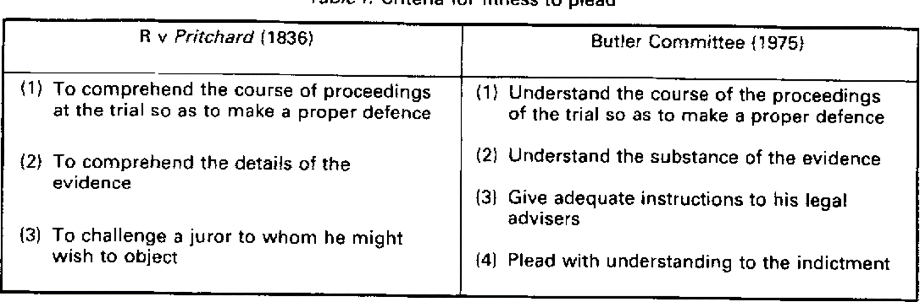

Slide 39
Pros Cons
No boss/organisation
No meetings
No Trust IT systems
Complete self-accountability
Work = income
No commute
Vast autonomy
Can say no
Reduced responsibility – no patients
No (guaranteed) income
No paid leave/holiday
Work could dry up
No colleagues
Revalidation, etc. more difficult
Admin/other support absent

Slide 40

Week 3 Day 2
So far so good
Range of cases
London to Wakefield
Bristol, Norfolk
The future?
Notes:
DV, incest, fighting, sexual offences, sexual assault
Dhaka, Red Army soldier, travellers, Bangladesh, India
SZP, SZA, personality disorder, menopause, substance and alcohol and the mentally well

Slide 41
Please
Listen to the Medics Money Podcast
1
Get an accountant
2
Remember that you have inherent value – including financial
3
Change jobs if not enjoying, valued and fulfilled
4

